Slide 1
MICROGREENS
Dr. Shane Martin DC

Slide 2
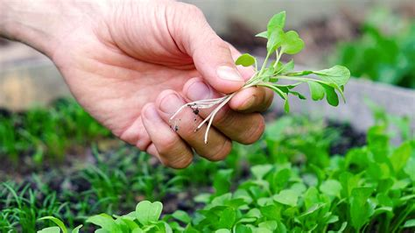
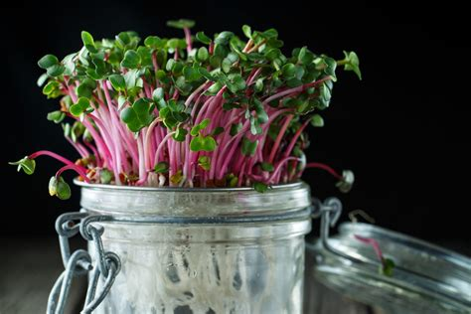
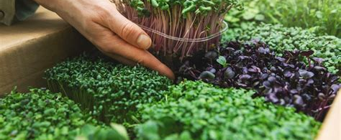
HEALTH BENEFITS OF MICROGREENS
-They’re nutrient-dense and a rich source of up to 25-40 times as many nutrients as mature vegetable greens.
-One oz of Broccoli microgreens is equal to 11 pounds of the adult plant
-This is a food that is energetically therapeutic (24 hours from harvest). A week or so after harvest a plant loses much of its vitality.

Slide 3
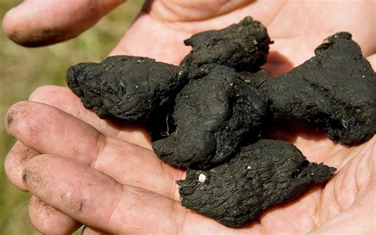
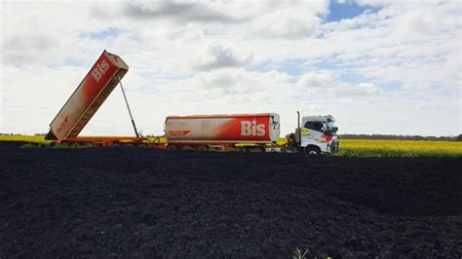
FOOD SAFETY
-At times we can't even trust organic produce.
-Even if GMO’s and pesticides are absent soil in this country is depleted of nutrition.
-Bio sludge is a human waste fertilizer that can be used in Organic produce.
-In the state of Washington liquified human cadavers are allowed, by law, to be used as fertilizer (this includes organic produce).

Slide 4
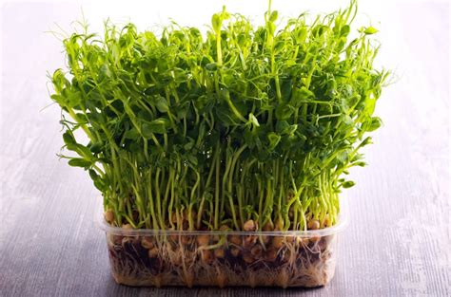
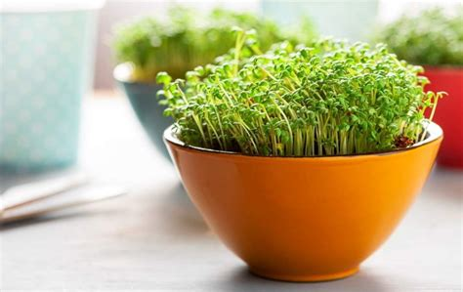
Microgreens bypass the risks of:
-Pesticides
-Use of bio sludge (on organic produce)
-Poor soil
-GMO’s
-Poor nutritional content
Microgreens are:
-Higher in nutritional density than mature plant
-More cost effective in nutritional density per dollar than
the mature plant
-More sustainable and locally grown
-Energetic (freshly harvested)

Slide 5
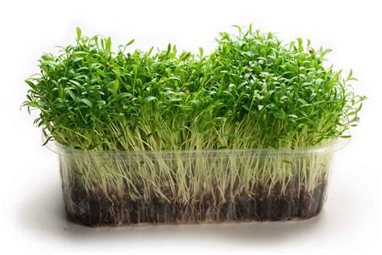
CONVENIENCE AND COST
-Typically, $25 is priced for one pound of microgreens (one tray) as opposed to $6 per pound of organic broccoli or spinach.
-However, microgreens give up to 6x to 10x of nutrition per dollar compared to the adult organic plant.
-One tray/pound of microgreen broccoli is equal to more than 150 pounds of the adult plant.
-This helps geriatrics get their nutrition while eating and paying less.
-Easy to feed to children nutritionally dense vegetables this way.

Slide 6
DISEASE TREATMENT
Reducing Heart Disease
Vitamin K is an essential vitamin that is needed by the body for blood clotting and other important processes.
Improving vitamin K status may boost cardiovascular health by reducing arterial stiffness and improving blood pressure, says a new study published in the Journal of the American Heart Association.
Fighting Cancer
Sulforaphane derives from the glucosinolate found in broccoli microgreens and has been widely researched and proven for its chemoprevention properties.
Healthier Eyes
Over 40? No? Just wait, you’ll likely be squinting at your phone soon. Unless you’re planning on eating a lot leafier greens, including microgreens. Lutien (pronounced LOO-teen) is an important eye nutrient that may reduce your risk for macular degeneration (AMD) and cataracts.
Several studies have found that lutein can help prevent AMD or may slow progression of the disease.
Lutien is found in many green leafy plants, including spinach and Swiss chard microgreens .

Slide 7
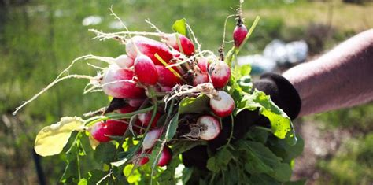
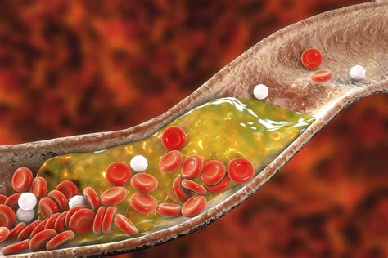
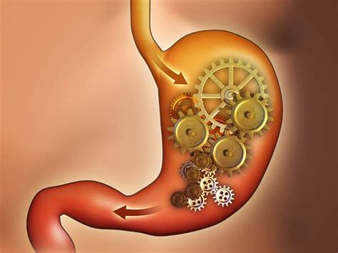
DISEASE TREAMENT
Improving Digestion
Healthy foods that possess properties to encourage the natural growth of beneficial gut bacteria are called Prebiotics.
Cruciferous microgreens (broccoli and cabbage) are prebiotics proven to improve the body’s natural resistance to invading pathogens.
Lowering Cholesterol
Researchers found that eating red cabbage microgreens can lower LDL cholesterol and triacylglycerol levels.
Their data further suggested that microgreens can help to control weight and may protect against cardiovascular disease, the leading cause of death in America.

Slide 8
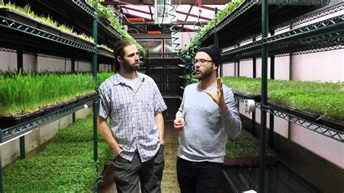
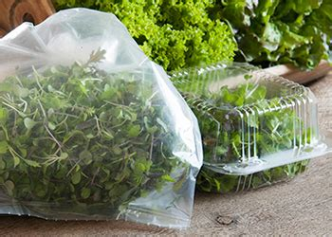
HOW MICROGREENS ARE GROWN
1-1/2-1oz of non-GMO seeds (Kale, Sunflower, Broccoli, Radish, Pea, etc) are spread over a bed of organic soil.
2-Trays are watered and left in the dark to promote germination of seeds.
3-Once germination begins trays are placed under grow lights in a climate-controlled facility for one week.
4-After one-week plants are sprouting leaves and are ready for harvest.
5-Plants are harvested and packaged for same day delivery.
6-Old soil is not re-used (unless growing wheat grass) and is composted.

Slide 9
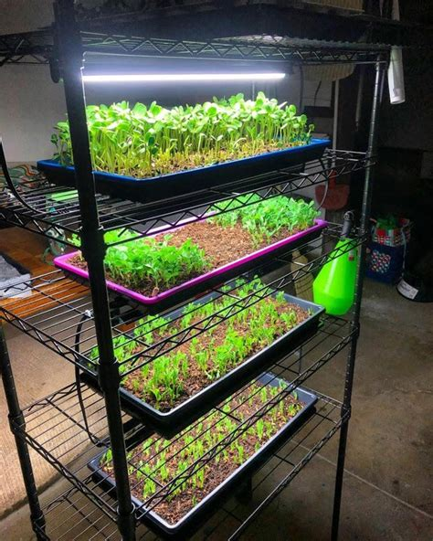
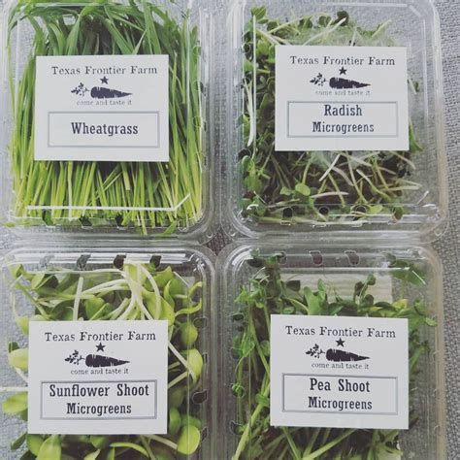
SETUP
SETUP
-Trays are $25 per tray (about one pound of microgreens).
-Harvested “trays” are ordered 10 days in advance then picked up at specified days and locations (same day harvest).
-Clients place orders online or may use a QR codes.

Slide 10
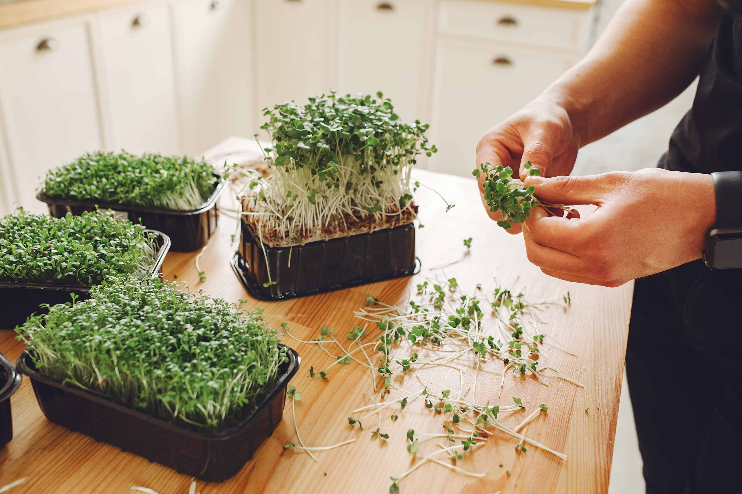
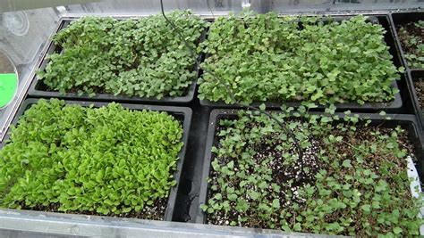
OPERATIONS
-5 of the most nutritionally dense microgreens will be made available:
Kale, Radish, Broccoli, Pea, Sunflower
-Microgreens grown in a climate-controlled environment using:
Organic soil
Full spectrum LED lights
Non-GMO seedlings
-Microgreens are harvested every 10-12 days

Slide 11
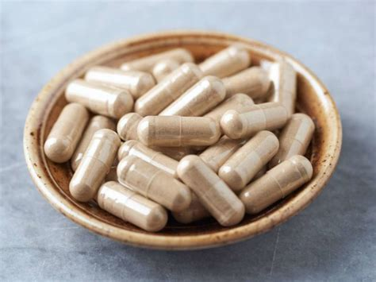
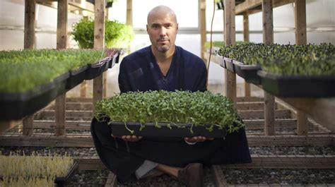
SUPPLEMENTS
-Microgreens can be used in conjunction with and can enhance Supplement absorption.

Slide 12
SUMMARY
-Microgreens are cost effective
-Microgreens have more nutrition than the adult plant
-Microgreens are Safe
-Microgreens may be used to treat disease
-Microgreens are great for introducing vegetables to children
-microgreens keep the elderly healthy while eating and paying for less

Slide 13
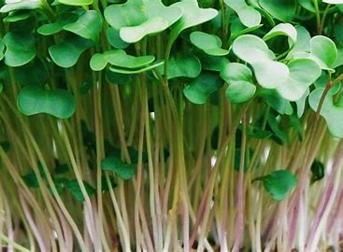
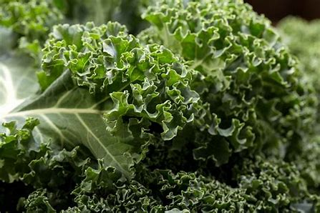
Kale Microgreens are simply young versions of the same plant, but contain as much as 4 times more nutrients then a full mature kale plant. Which makes it a very beneficial microgreen for you're overall health.
Kale microgreens are loaded with powerful antioxidants such as beta-carotene, vitamin C, flavonoids and polyphenols. These antioxidants have cardiovascular and immune system health benefits.
Other Health Benefits Include:
Improves Digestion
Aids in Weight Loss
Improves eye health
Protects you against diabetes
Anti-Cancer Properties
Reduces risk of heart disease
Helps prevent osteoporosis
Reduces Blood Pressure

Slide 14
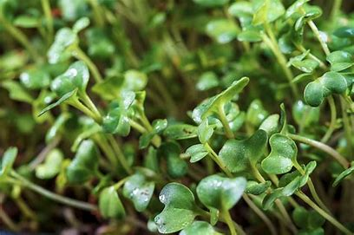
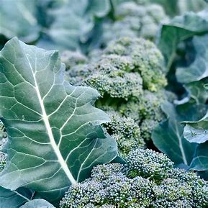
Broccoli Microgreens are amazing because they actually contain all of these essential and powerful nutrients just 8-12 days after germination. Broccoli microgreens have more nutrients, vitamins and minerals than a head of broccoli.
Broccoli as microgreens are also an incredible source of protein and they are just super tasty. You can use this microgreen in most dishes or simply as a beautiful garnish.
List of Health Benefits Include:
Anti-Cancer Properties
Supports Cardiovascular Health
Anti-Diabetic Properties
Anti-Aging Properties
Boosts Brain Function

Slide 15
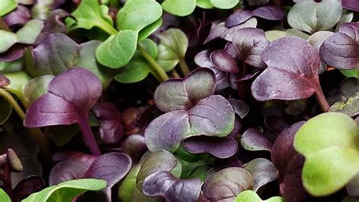
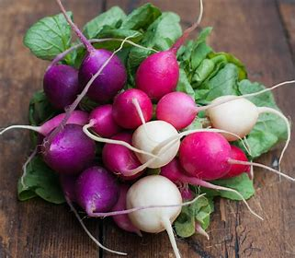
Radish Microgreens are the fastest growing microgreens of all. These microgreens are very easy to grow and can be harvested as early as a week.
Radish microgreens have a very spicy flavor and very much resemble the case of radishes. These microgreens can be added to soups and sandwiches for a spicy and crunchy flavor.
These microgreens are high in vitamins A, B, C, E, and K as well as carotene. They also contain potassium, and are high in dietary fiber. Due to all there nutritional content they contain many health benefits including cardiovascular, cancer preventive, and weight loss benefits.
List of health benefits include:
Promotes Digestion
Good for you're skin
Improves immunity
Controls Blood Pressure
Improves Hydration
Detoxifies you're Blood

Slide 16
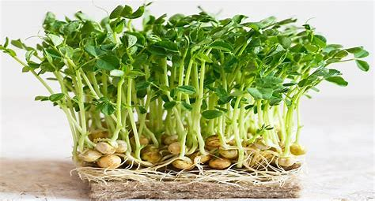
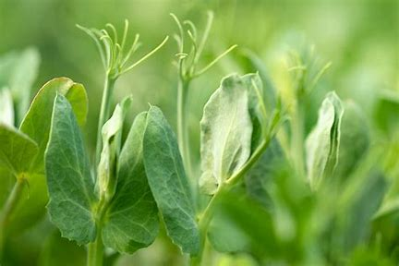
Pea Microgreens are mini veggies filled with high nutrition. Having a sweet and tender taste, these mini leaves are excellent to eat both raw or cooked. They also make a great garnish or addition to any salad.
Due to how many antioxidants they have they provide many anti-inflammatory, cardiovascular and cancer preventing health benefits.
Other Health benefits Include:
Lowers Risk of Diabetes
Supports Weight Loss
Improves you're Heart Health
Prevents Anemia
Reduces the risk of infections
Reduces the risk of pneumonia
Reduces the risk of a stroke

Slide 17
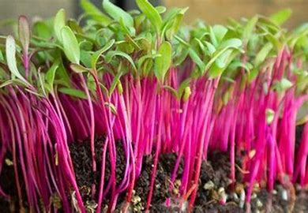
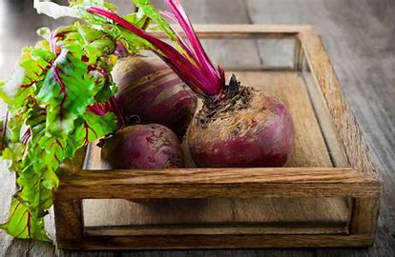
Beetroot Microgreens are an excellent variety for first-time growers, beetroot microgreens are very easy to grow and are usually ready to harvest in 12 to 15 days from seed. They are very nutritious containing many vitamins and minerals.
Beetroot microgreens have plenty of antioxidants, anti-inflammatory and body cleansing properties.
The list of health benefits include the following:
Helps build blood, revitalizes tissues and detoxifies the body
Prevents inflammations and removes fatigue
Fights against cancer
Anti Aging
Improves Skin Health
Lowers blood pressure
Reduces risk of heart disease
Reduces risk of strokes
Promotes Liver Health
Boosts Energy levels
Promotes Good Brain Health
Controls Blood Sugar Levels
Aids Digestion
Treats Anemia
Prevents Osteoporosis
Prevents Cataracts

